Slide 1
A Comparative Performance and Stability Analysis of 6T and 7T SRAM Cells for Low-Power Applications
Dr. T. Ravi, Naralasetti Umesh Surya Kiran, Vaddi Ugandhar
Sathyabama Institute of Science and Technology, Chennai, India

Slide 2
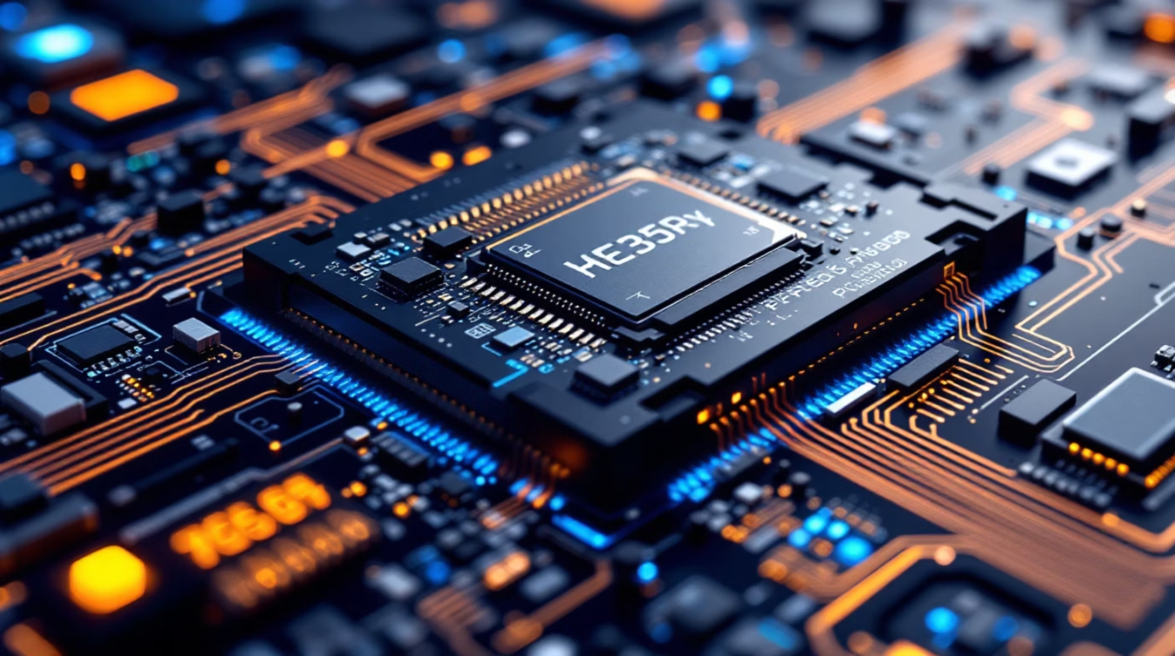
SRAM: The Foundation of Modern Computing
Static random-access memory (SRAM) serves as the primary on-chip storage element in processors, cache memories, and embedded systems. Its fast access speed and compatibility with standard CMOS processes make it indispensable in modern digital integrated circuits.
As energy efficiency becomes critical in battery-powered electronics, reliable SRAM operation at reduced supply voltages has emerged as a key requirement for system-on-chip designs.

Slide 3
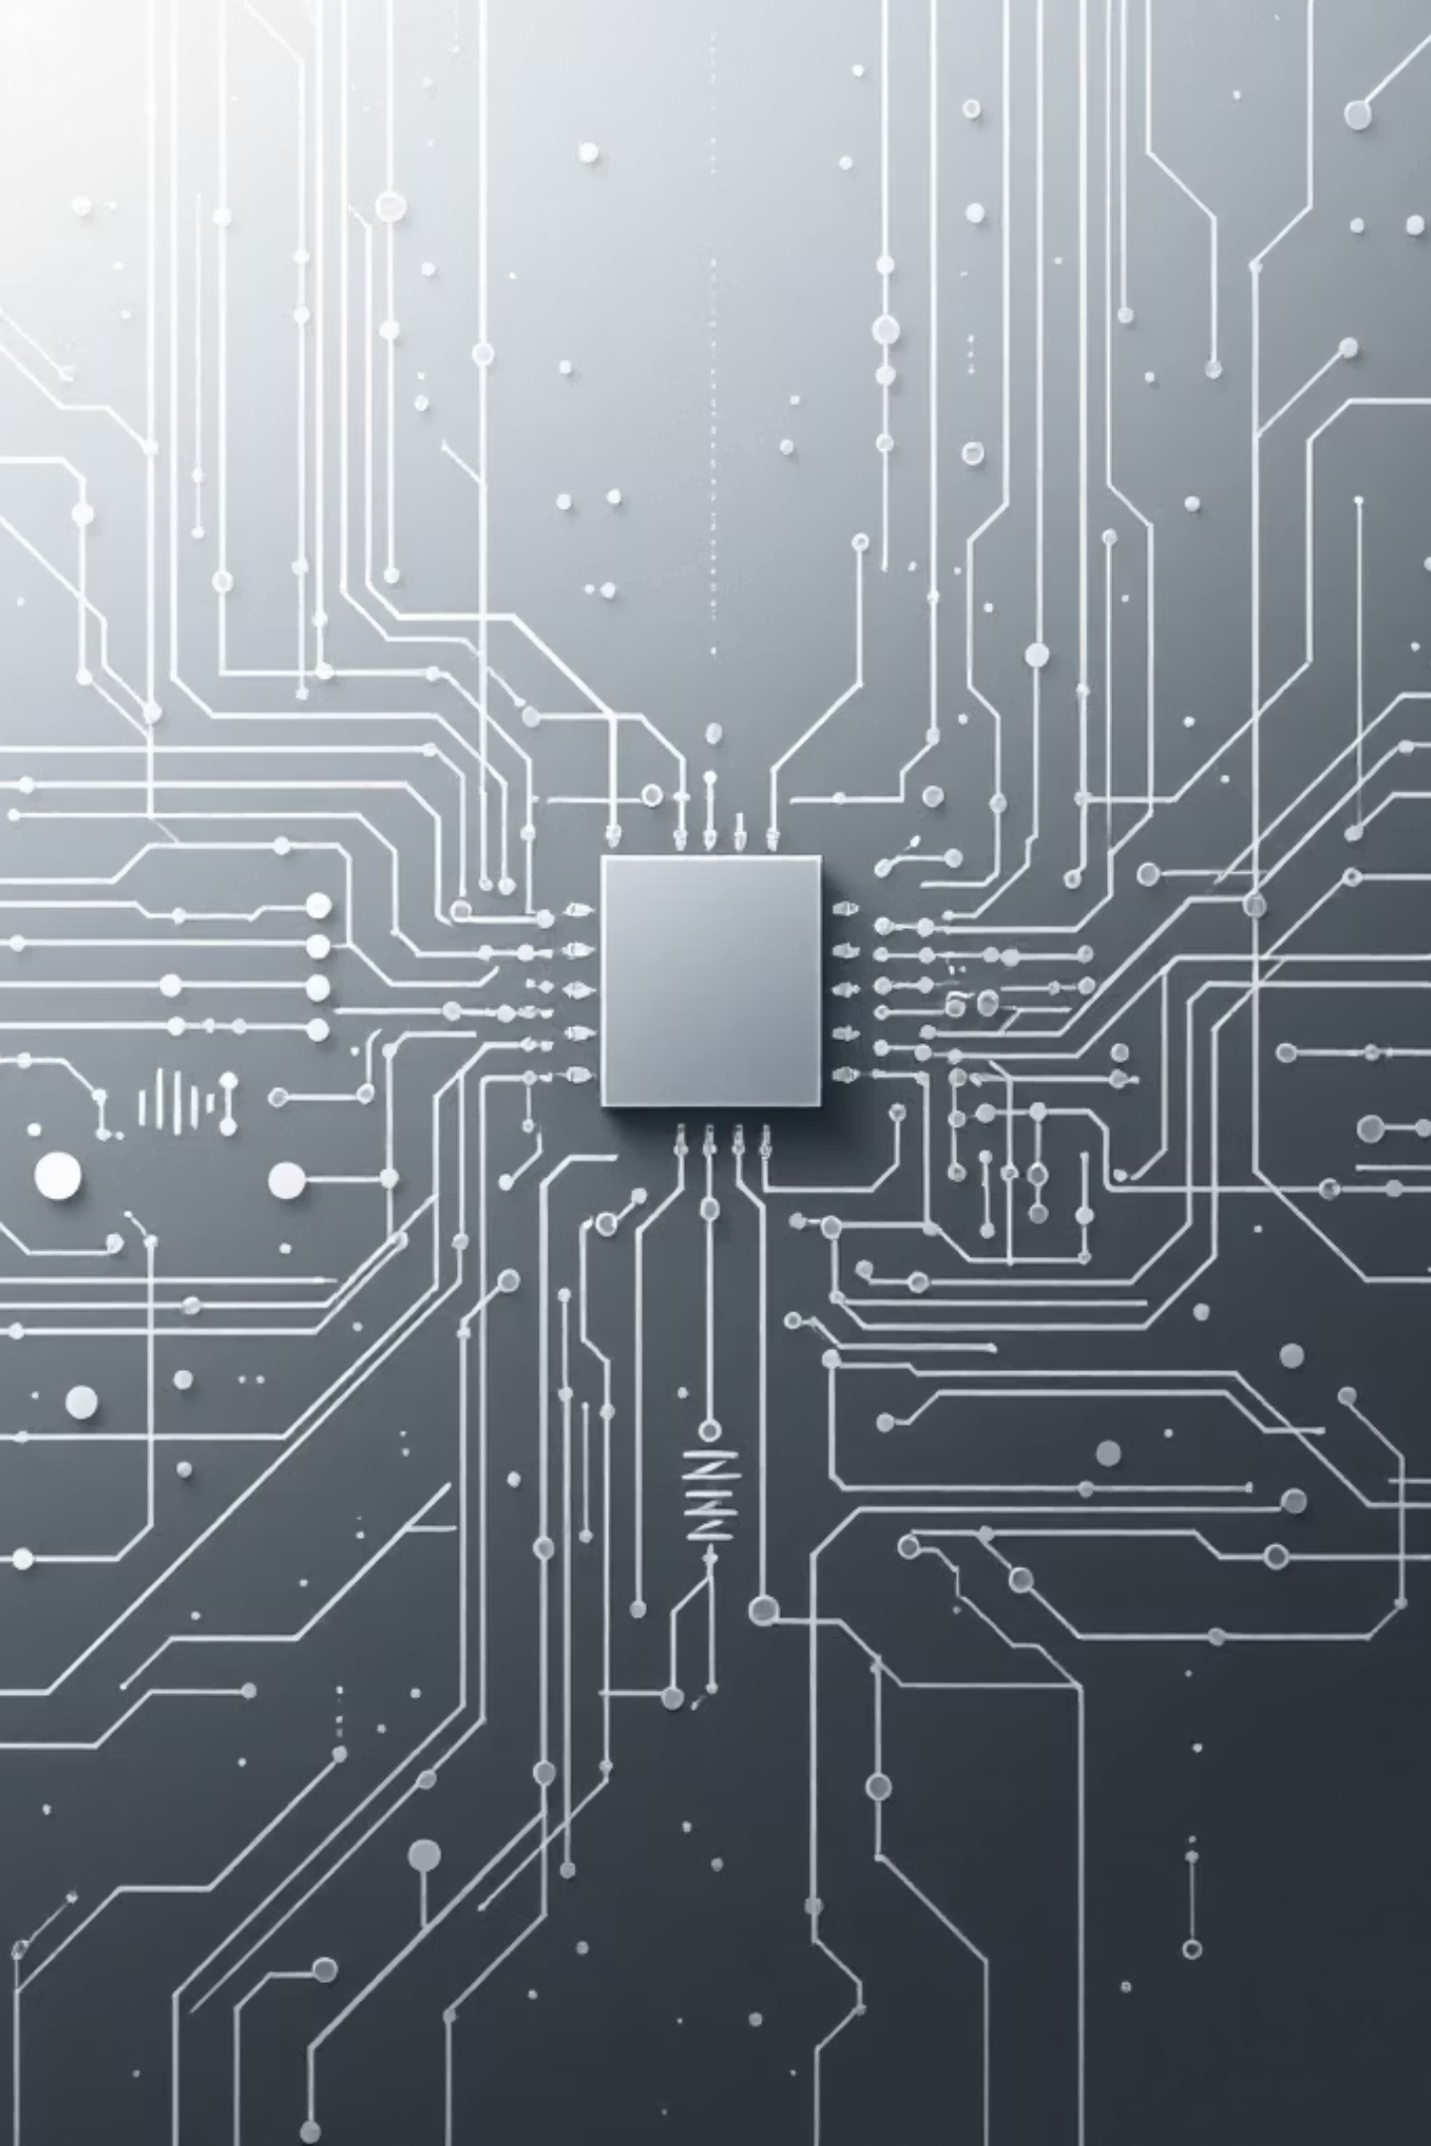



The Challenge of Voltage Scaling
Reduced Drive Strength
PVT Variations
Lower supply voltage degrades device performance and increases sensitivity to variations.
Process, voltage, and temperature variations exacerbate reliability issues at scaled voltages.
Read Disturb
Unintended disturbance of stored data during bitline sensing under low-voltage conditions.

Slide 4
6T vs 7T Architectures
Conventional 6T SRAM
Decoupled-Read 7T SRAM
Two cross-coupled inverters forming storage nodes
Two access transistors connecting to bitlines
Direct coupling between read path and storage nodes
Compact area with 6 transistors
Susceptible to read disturb effects
Additional transistor isolates read path
Eliminates read disturb during sensing
Enhanced read static noise margin
Increased area with 7 transistors
Improved low-voltage robustness

Slide 5
Methodology
01
02
03
Cell Implementation
Testbench Configuration
SNM Extraction
Both architectures implemented in identical CMOS technology using Cadence Virtuoso with comparable transistor sizing.
Dedicated testbench with precharge circuitry, control signals, and load capacitances for realistic interconnect emulation.
Static noise margin measured using DC sweep analysis and butterfly curve construction for hold and read modes.
04
05
Transient Analysis
Power Measurement
Read and write delays measured from wordline assertion to valid signal observation during dynamic operation.
Average power extracted using transient current integration over complete operating cycles for read and write operations.

Slide 6

Static Noise Margin Results
Significant Improvement
The 7T SRAM exhibits a 50% increase in static noise margin compared to conventional 6T architecture.
This improvement stems from complete isolation of the read operation from storage nodes, preventing bitline-induced voltage disturbance during read access.
6T SNM: 0.31 V
7T SNM: 0.47 V

Slide 7
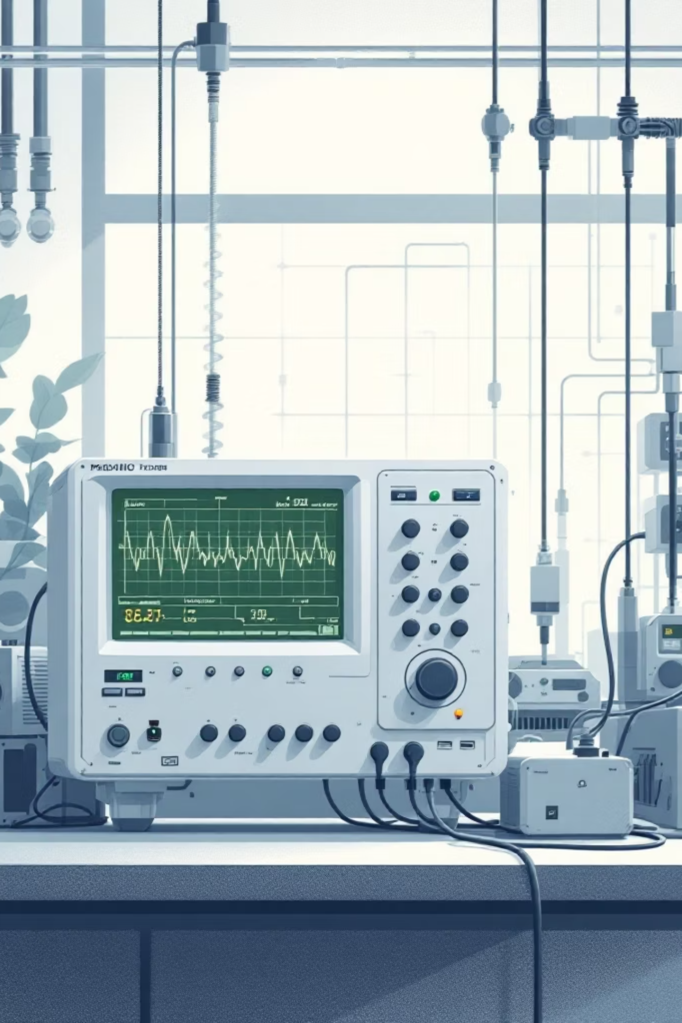
Power Consumption Analysis
9.17
11.41
24%
6T Power
7T Power
Power Increase
Average power consumption in μW
Average power consumption in μW
Additional overhead in 7T architecture
The 7T SRAM shows moderate power increase due to additional read transistor and control circuitry. However, the overhead remains justified by substantial improvement in read stability, with dynamic power dominated during read operations where enhanced robustness is most critical.

Slide 8
Timing Performance Trade-offs
38.1%
48.7%
Read Delay Increase
Write Delay Increase
7T vs 6T architecture
7T vs 6T architecture
6T Advantages
7T Trade-offs
Lower read delay: 1.18 ns
Lower write delay: 0.92 ns
Direct access mechanism
Stronger pull-down paths
Higher read delay: 1.63 ns
Higher write delay: 1.34 ns
Single-ended sensing
Additional parasitic capacitance

Slide 9

Key Trade-offs Summary
Stability vs Efficiency
7T SRAM provides superior read stability and noise margin at the cost of increased delay and power consumption.
Area Overhead
Additional transistor increases silicon area but enables reliable low-voltage operation in near-threshold regimes.
Application-Specific Choice
Architecture selection depends on whether robustness or raw performance is prioritized in target application.

Slide 10



Conclusion and Future Directions
This comprehensive analysis demonstrates that 7T SRAM significantly improves read stability through decoupled read paths, achieving 50% increase in static noise margin compared to conventional 6T architecture.
Trade-off Recognition
Optimization Path
Promising Solutions
Improved robustness accompanied by increased delay, power, and area overhead.
Architectural and timing-level optimizations needed for standard 6T SRAM reliability enhancement.
Replica-assisted adaptive wordline control for robust, energy-efficient SRAM operation.
The findings strongly support adoption of assist circuit techniques as promising solutions for achieving robust and energy-efficient SRAM operation in modern low-power and memory-centric computing systems.

